Slide 1

Data Science SQL Final Project
IPL AUCTION PROJECT

Slide 2
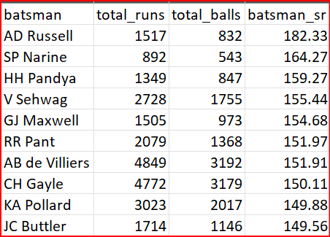
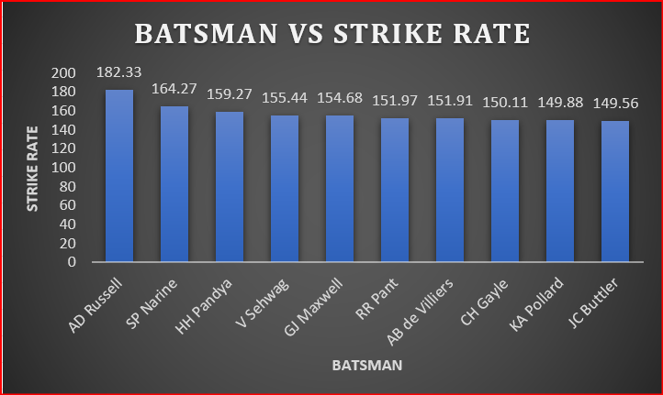
TASK 1 : Query SELECT Batsman, SUM(batsman_runs) as Total_Runs, Count(ball) as Total_Balls, Round((sum(batsman_runs)*1.0 / COUNT(ball)) * 100,2) AS batsman_sr FROM Ipl_balls WHERE extras_type not in ('wides') GROUP BY batsman HAVING COUNT(ball) > 500 ORDER BY batsman_sr DESC LIMIT 10;

Slide 3
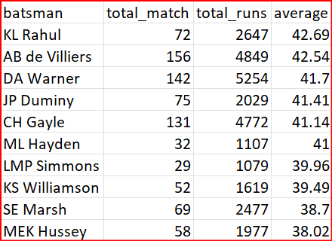
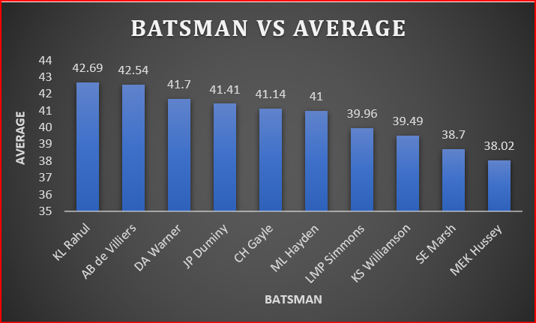
TASK 2 : Query Select Batsman, COUNT(distinct id) as Total_Match, SUM(batsman_runs) as Total_Runs, Round(SUM(batsman_runs)*1.0/sum(is_wicket),2) as Average from Ipl_balls Group by Batsman Having SUM(is_wicket) > 2 AND COUNT(distinct id) > 28 Order By Average DESC LIMIT 10;

Slide 4
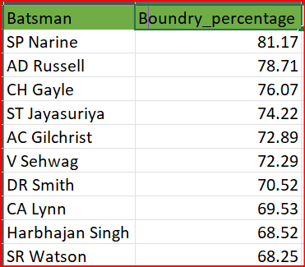
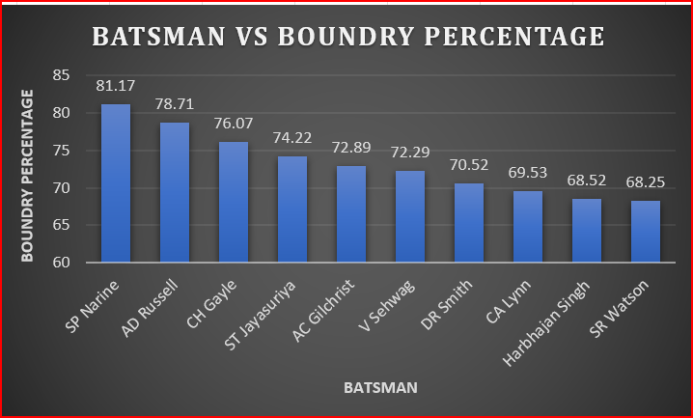
TASK 3 : Query Select Batsman, Round(Sum(Case When batsman_runs in (4,6) Then batsman_runs else 0 END)* 1.0 / SUM(batsman_runs)*100, 2) AS BOUNDRY_PERCENTAGE FROM IPL_BALLS Where extras_type NOT IN ('wides') GROUP BY batsman HAVING COUNT(DISTINCT id) > 28 ORDER BY BOUNDRY_PERCENTAGE DESC LIMIT 10;

Slide 5
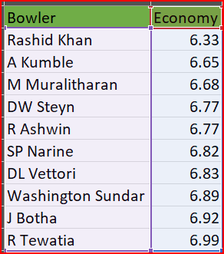
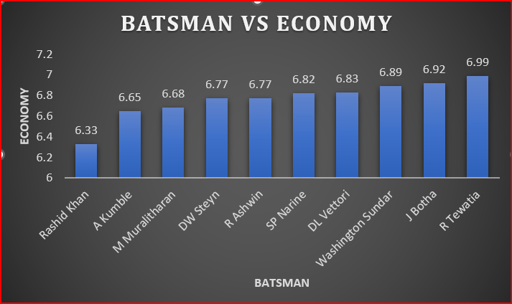
TASK 4 : Query Select Bowler, ROUND(SUM(total_runs)/(COUNT(bowler)/6.0), 2) as Economy FROM Ipl_Balls Group By Bowler Having count(bowler) > 500 Order By Economy Limit 10;

Slide 6
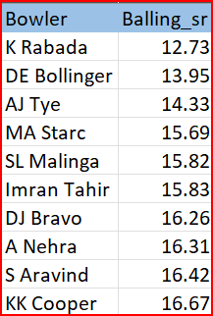
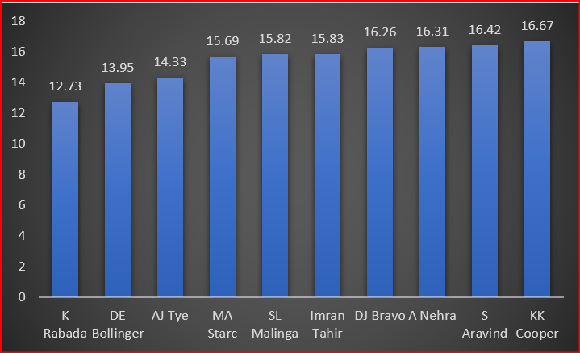
TASK 5: Query Select a.bowler, Round((a.total_balls/(a.total_wickets*1.0)),2) as Balling_SR from (select bowler, Sum(case when is_wicket=1 then 1 else 0 end) as total_wickets, count(ball) as Total_balls from IPL_balls group by bowler) as a where Total_balls>=500 order by Balling_SR asc limit 10;

Slide 7
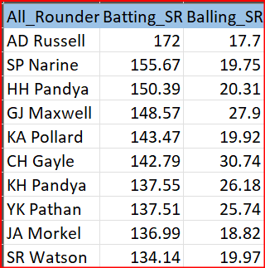
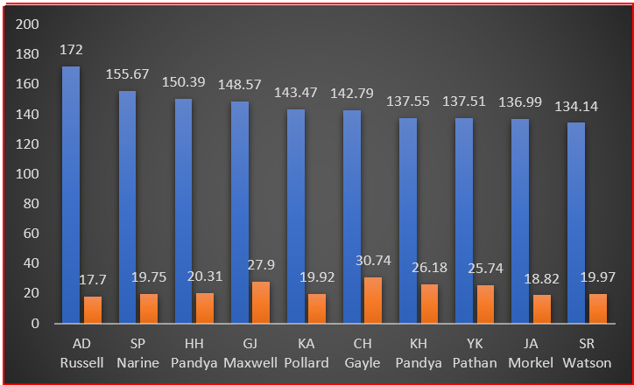
TASK 6 : Query Select a.Batsman AS All_Rounder, a.Batting_SR AS Batting_SR, b.Balling_SR AS Balling_SR FROM (SELECT Batsman, Round((sum(batsman_runs)*1.0 / COUNT(ball)) * 100,2) AS Batting_SR from IPL_balls group by batsman having count (ball)>=500 order by Batting_SR desc) as a JOIN (SELECT bowler, Round(count(ball)*1.0/sum(case when is_wicket=1 then 1 else 0 end),2) as Balling_SR from IPL_balls group by bowler having count(ball)>=300 order by Balling_SR asc) as b on a.Batsman = b.Bowler limit 10;

Slide 8
Best wicketkeepers for a T20 team in the IPL
Batting Ability: High strike rate and ability to score quick runs.
Wicketkeeping Skills: Quick reflexes, safe hands, and proficiency in catching and stumping.
Adaptability: Ability to adjust batting style and game approach according to match situations.
Fielding Prowess: Agile and athletic, capable of contributing to outfield fielding and taking catches.
Leadership and Communication: Effective communication with bowlers and fielders, and leadership qualities.
Versatility: Capability to contribute with occasional bowling, adding depth to the team.
Big Match Temperament: Performance under pressure and in crucial matches.

Slide 9
Additional Questions

Slide 10
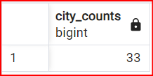
Q 1. Get the count of cities that have hosted an IPL match. Query : Select Count(Distinct City) AS City_Counts from IPL_Matches; Here, City count is 33 including ‘NA’, So the actual city count is 32.

Slide 11
Q 2. Create table deliveries_v02 with all the columns of the table ‘deliveries’ and an additional column ball_result containing values boundary, dot or other depending on the total_run. Query : CREATE TABLE Deliveries_v02 AS SELECT *, CASE WHEN total_runs >= 4 THEN 'boundary' WHEN total_runs = 0 THEN 'dot' ELSE 'other’ END AS ball_result FROM IPL_balls;

Slide 12
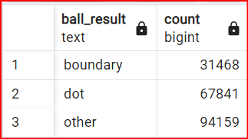
Q3. Write a query to fetch the total number of boundaries and dot balls from the deliveries_v02 table. Query : SELECT Ball_Result, COUNT(Ball_Result) FROM Deliveries_v02 GROUP BY Ball_Result;

Slide 13
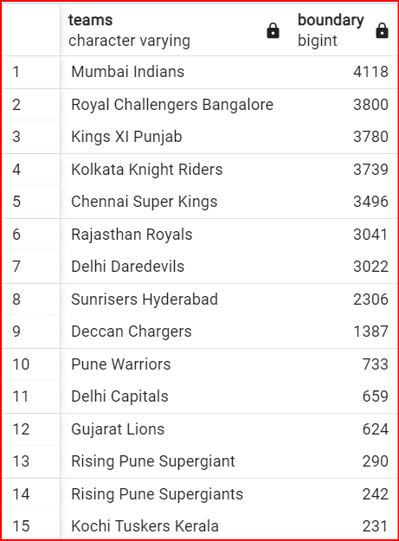
Q4. Write a query to fetch the total number of boundaries scored by each team from the deliveries_v02 table and order it in descending order of the number of boundaries scored. Query : Select Batting_Team as Teams, Count(Ball_result) AS Boundary from Deliveries_v02 where Ball_result='boundary’ Group By Teams order by Boundary desc;

Slide 14
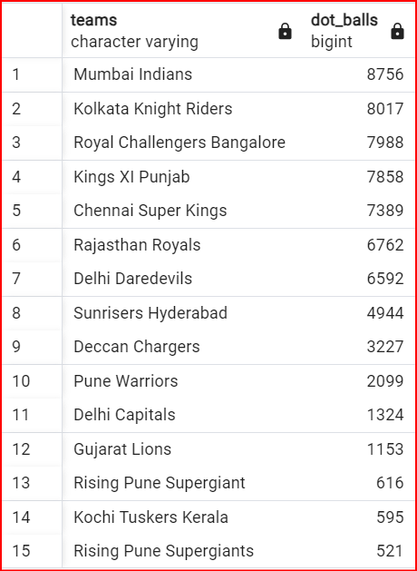
5. Write a query to fetch the total number of dot balls bowled by each team and order it in descending order of the total number of dot balls bowled. Query : SELECT Batting_Team AS Teams, COUNT(Ball_result) AS Dot_Balls FROM Deliveries_v02 WHERE Ball_result='dot’ Group By Teams ORDER BY Dot_Balls DESC;

Slide 15
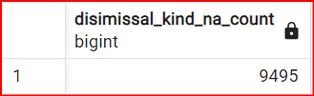
Q6. Write a query to fetch the total number of dismissals by dismissal kinds where dismissal kind is not NA. Query : SELECT COUNT(dismissal_kind) AS Disimissal_Kind_NA_Count FROM Deliveries_v02 WHERE dismissal_kind != 'NA';

Slide 16
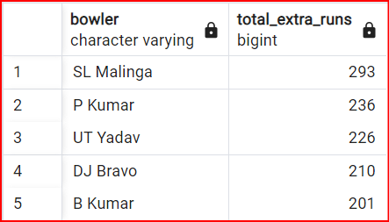
Q7. Write a query to get the top 5 bowlers who conceded maximum extra runs from the deliveries table Query : SELECT Bowler, SUM(extra_runs) AS Total_Extra_Runs FROM Deliveries_v02 GROUP BY Bowler ORDER BY Total_Extra_Runs DESC LIMIT 5;

Slide 17
Q8. Write a query to create a table named deliveries_v03 with all the columns of deliveries_v02 table and two additional column (named venue and match_date) of venue and date from table matches Query : CREATE TABLE deliveries_v03 AS SELECT d.*, m.venue , EXTRACT(DAY FROM m.date) AS Match_date FROM deliveries_v02 d LEFT JOIN IPL_Matches m ON d.id = m.id;

Slide 18
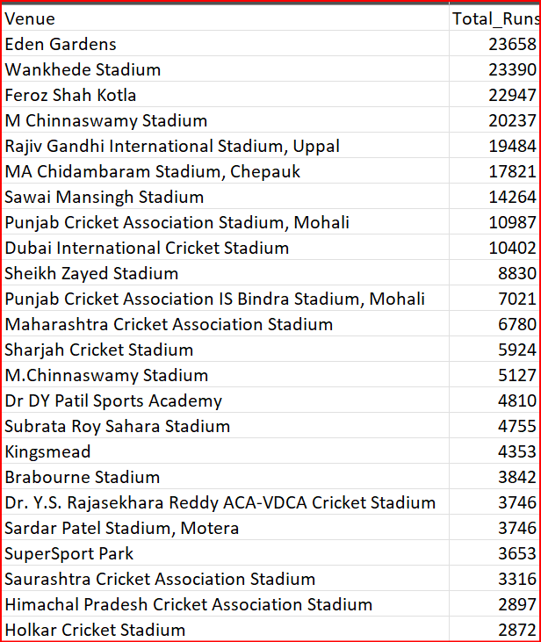
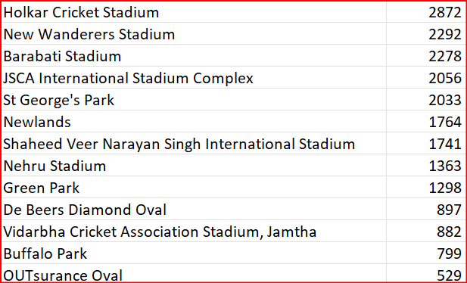
Q9. Write a query to fetch the total runs scored for each venue and order it in the descending order of total runs scored. Query : SELECT Venue, Sum(Total_runs) AS Total_Runs FROM deliveries_v03 GROUP BY Venue ORDER BY Total_Runs DESC;

Slide 19
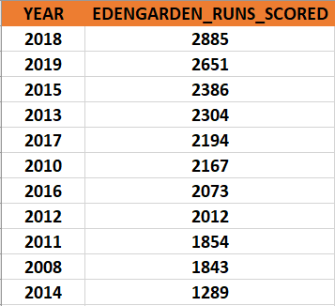
Q10. Write a query to fetch the year-wise total runs scored at Eden Gardens and order it in the descending order of total runs scored. Query : SELECT Extract(Year FROM match_date) AS Year, SUM(runs_scored) AS EDENGARDEN_RUNS_SCORED FROM deliveries_v03 WHERE venue = 'Eden Gardens’ GROUP BY Year ORDER BY EDENGARDEN_RUNS_SCORED DESC;

Slide 20
Thank You!

